Slide 1
VIRTUALIZATION

Slide 2
What is Virtualization?
Virtualization is a technology to run multiple same or different operating systems which are completely isolated from each other on the same machine.
Example: Run both Windows and Linux on the same machine

Slide 3
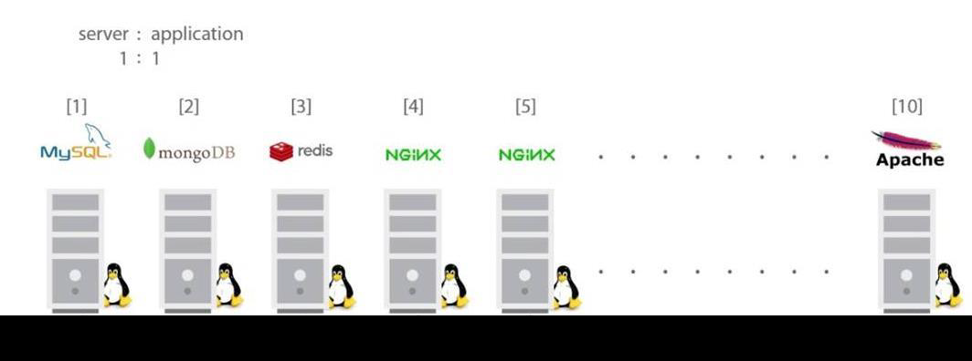
Problem
VIRTUALIZATION

Slide 4
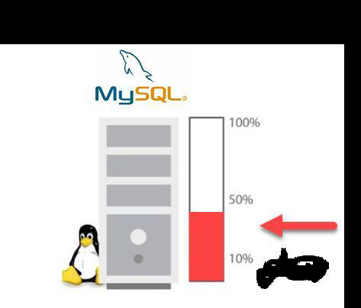
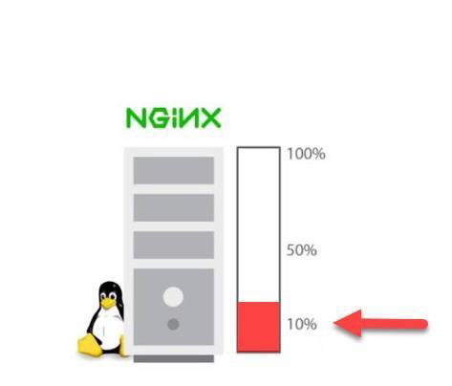

Slide 5
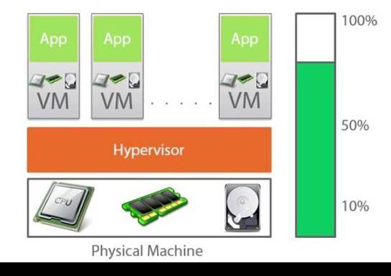

Slide 6
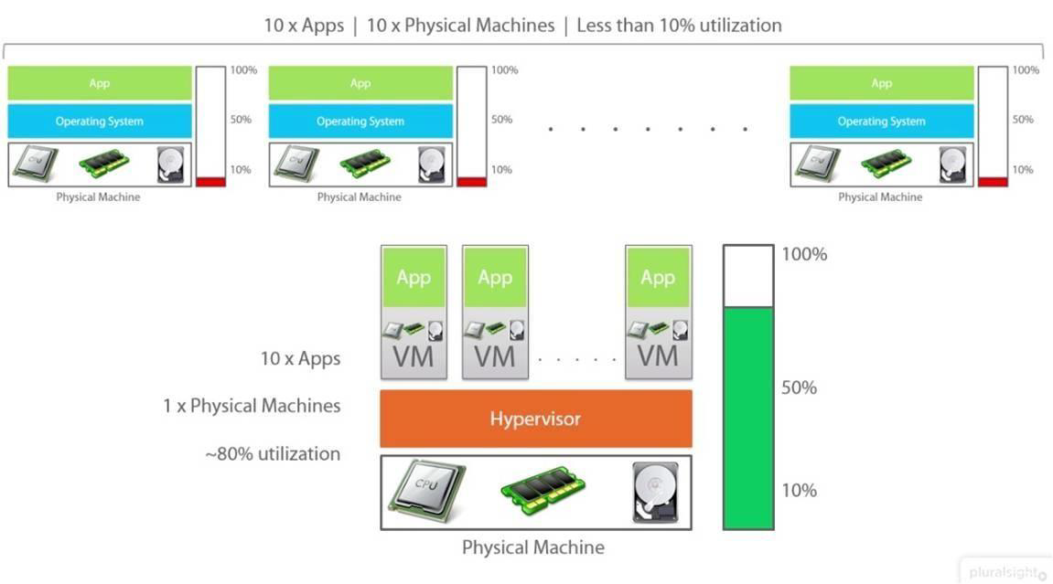

Slide 7
HOW IT IS DIFFERENT FROM DUAL BOOT?
Dual boot is having 2 OS installed on same computing and choosing which to turn on at boot time
With Virtualization, both OSes run simultaneously

Slide 8
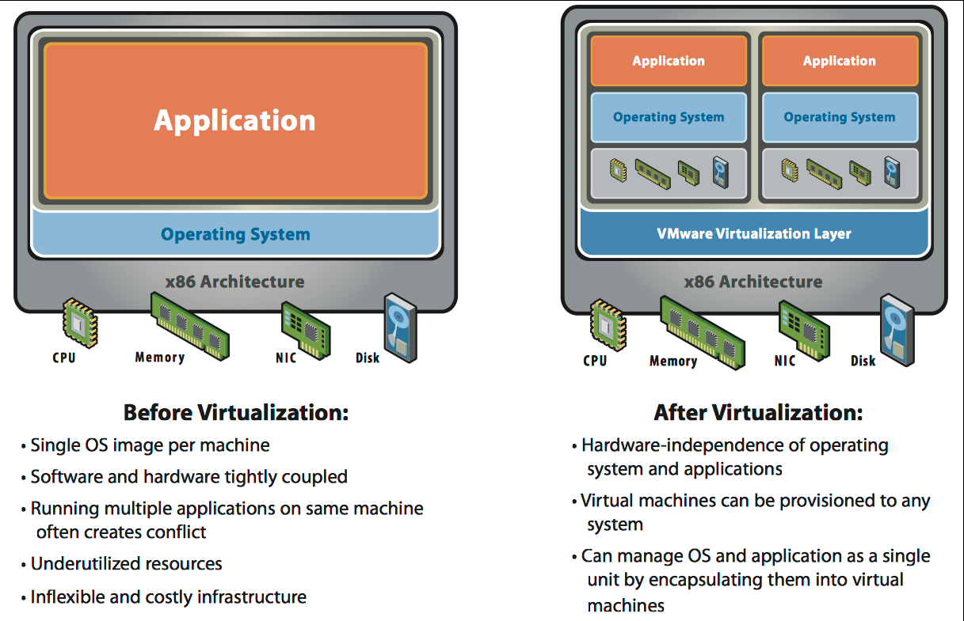

Slide 9
Virtualization and Cloud Computing
Virtualization is a technology whereas Cloud Computing is a service.
Without virtualization, there is no Cloud Computing.
Cloud Computing is built on top of Virtualization.

Slide 10
What IS Hypervisor?
Hypervisor is a software layer that sits between Hardware and OS which will interact with hardware and resources and provide an interface to share the available resources to virtual containers.

Slide 11
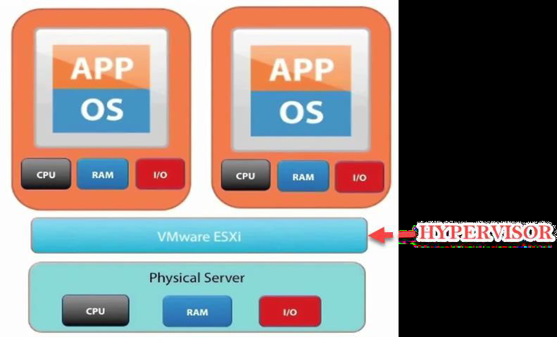

Slide 12
Virtualization Benefits
Virtualization offers major savings in data center operations.
Virtualization makes possible significant reductions in the costs of managing data centers, with simplification of systems management tasks.
Virtualization offers back-up and increased redundancy for delivery of high performance and high availability services.
Virtualization is a step in the direction of “cloud computing”.
Centralized management

Slide 13
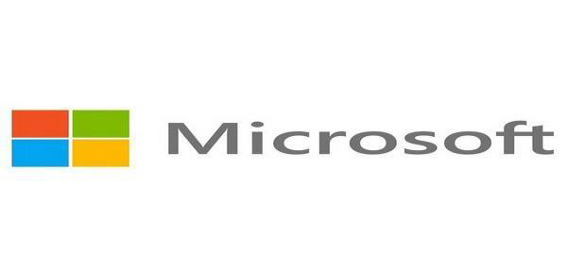

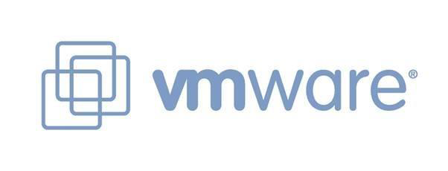
Vendors

